Slide 1
Importance of Data Analytics
Notes:
Cover Self Introduction , start with your experience and questions
Talk about self & experience
What is data , how it has started and what we have today with some quotes
Data analytics is important in business to understand problems facing an organization, and to explore data in meaningful ways. Data in itself is merely facts and figures. Data analysis organizes, interprets, structures and presents the data into useful information that provides context for the data. This context can then be used by decision-makers to take action with the aim of enhancing productivity and business gain.
Data Analytics refers to qualitative and quantitative techniques and processes used to enhance productivity and business gain.” Data is extracted, acknowledged and bifurcated to identify and analyze behavioral data, techniques and patterns can be dynamic according to a particular business’s need or requirement. Data Analytics is a broader term that has analysis as a subhead and analytics is basically the concepts used to do the analysis.
Data analytics involves combing through massive datasets to reveal patterns and trends, draw conclusions about hypotheses, and support business decisions with data-based insights. Data analysis attempts to answer questions such as, “What is the influence of geography or seasonal factors on customer preferences?” or “What is the likelihood a customer will defect to a competitor?”. The practice of data analytics encompasses many diverse techniques and approaches and is also frequently referred to as data science, data mining, data modeling, or big data analytics.
OBJECTIVE: We will learn how important is the role of Data Analyst, Data Scientists, different tools & technologies which plays a vital role in uncovering the information lies beneath data.

Slide 2





Data Analytics
Data analytics is the science of qualitative and quantitative representation of data which helps businesses make decisions
Data analytics is a broad term that encompasses many diverse types of data analysis.
Data analytics help a business optimize its performance.
Data is extracted and categorized, transformed & processed over time according to organizational requirements.
Data Analytics is not – Data Science , Big Data , AI or Machine Learning
Notes:
WHAT & WHY ?
Data analysis is a go from a mass of data to meaningful insights.
Data analysis is a primary component of data mining and Business Intelligence (BI) and is key to gaining the insight that drives business decisions.
Data Science – concept that unifies statistics, data analysis and their related methods in order to understand and analyze phenomena with data. It employs techniques and theories drawn from many fields with in the broad areas of mathematics, statistics, information science and computer science
Big data is defined as high-volume, high velocity and high variety information assets that demand innovative forms of information processing for enhanced insight and decision making
Data analytics is the process of collecting and examining raw data in order to draw conclusions about it. Every business collects massive volumes of data, including sales figures, market research, logistics, or transactional data. The real value of data analysis lies in its ability to recognize patterns in a dataset that may indicate trends, risks, or opportunities. Data analytics allows businesses to modify their processes based on these learnings to make better decisions. This could mean figuring what new products to bring to market, developing strategies to retain valuable customers, or evaluating the effectiveness of new medical treatments.
Most commonly-used data analysis techniques have been automated to speed the analytical process. Thanks to the widespread availability of powerful analytics platforms, data analysts can sort through huge amounts of data in minutes or hours instead of days or weeks using:
Data mining: Involves sorting through large data sets to identify trends, patterns, and relationships.
Predictive analytics: Aggregates and analyzes historical data to help organizations respons appropriately to future outcomes like customer behavior and equipment failures.
Machine learning: Uses statistical probabilities to teach computers to process data faster than conventional analytical modeling.
Big data analytics: Applies data mining, predictive analytics, and machine learning tools to transform data into business intelligence.
Text mining: Spots patterns and sentiments in documents, emails, and other text-based content.
As more organizations move their critical business applications to the cloud, they are gaining the ability to innovate faster with big data. Cloud technologies create a fast-moving, innovative environment where data analytics teams can store more data and access and explore it more easily, resulting in faster time to value for new solutions.
WHY ?
Data Analytics is needed in Business to Consumer applications (B2C). Organizations collect data that they have gathered from customers, businesses, economy and practical experience. Data is then processed after gathering and is categorised as per the requirement and analysis is done to study purchase patterns and etc.

Slide 3
Data Analytics Types
Descriptive analytics
What has happened over a given period of time
Diagnostic Analytics
Focuses on what’s going on and why ?
Predictive analytics
Focuses more on what can happen based on existing data patterns.
Prescriptive analytics
Focuses more on what can happen based on existing data patterns.
Notes:
The first stage of business analytics is descriptive analytics. This is the primitive stage that has been there for decades. Here we try to answer the question, what happened in the past? Simple and ready-made analytics.
The second stage is exploratory data analytics. This stage answers the question, what is going on? This is a deep dive into the data to understand behavior and discover patterns.
The third stage is explanatory analytics. This stage answers the question, why did it happen? This is a targeted exploration and reason-finding effort to answer a specific business question.
The fourth stage is predictive analytics. This stage answers the question, what will happen? It tries to predict the future based on the events that happened in the past.
The fifth stage is prescriptive analytics. This stage recommends steps and actions to take advantage of future predictions and to come up with business plans.
The final stage is experimental analytics. This stage provides guidance of how well the prescriptions will work based on expected environmental behavior
Descriptive analysis entails examining data and content manually with the aim of understanding what happened. Some of the techniques that a business can employ to do this include business intelligence and visualizations. Predictive analysis, on the other hand, attempts to predict the outcome by employing techniques such as regression analysis, forecasting and predictive modeling. Finally, prescriptive analysis is an advanced form of analytics that aims to find suitable solutions to the problems identified in the first and second levels of analytics. Some of the techniques employed in predictive analytics include complex event processing, simulation and recommendation engines.

Slide 4
Data Analytics Process
Data Ingestion
Data Preprocessing
Clean Structured Data
Data Insights
Reports/Dashboards
Visual Graphs
Raw Data
Data Driven Products
Models and Algorithms
Notes:
Explain the steps involved in data analytical product development
Talk about Data Mart , Data Warehouse , Data Lakes when data is pre-processed / crunched/ massaged

Slide 5
Data Analytics Compared
Process | Data Engineer | Data Analyst | Data Scientist
Integrate Data Sources
Build Data Pipelines
Process and Transform Data
Store Data
Dashboard and Reports
Diagnostics Analytics
Statistical Modelling
Machine Learning
Business Recommendation
Business Action
Notes:
How different roles are compared
If you have been watching the analytics horizon over the past few years, there are a few buzzwords that stand out, the most important of them being business analytics, business intelligence, data engineering, and data science. How are these terms different? How are they similar? Let us find out. When you look at the various activities associated with data inside a business, they can be defined as the following.
It starts from getting data from data sources and building data pipelines. Then data is processed, transformed, and stored. The processed data is used to build dashboards and reports. This then becomes the basis for exploratory analytics, statistical modeling, and machine learning. They then translate into business recommendations and actions. Which of these process elements are covered in each of these terms?
Let us start with data engineering. Data engineering covers the acquisition, processing, transformation, and storing of data. This is the heavy lifting work to get the data ready for analytics.
Business intelligence is the basic analytics of data which includes dashboards, reports, exploratory analytics, and getting business recommendations out of them.
Business analytics covers all the activities of business intelligence. In addition, it includes advanced activities like statistical modeling, machine learning, and also delivering business actions out of these.
Data science covers all the process activities. It is data engineering and business analytics added into one.
The task of a Data Scientist is to unearth future insights from raw data. Data engineer focuses on development and maintenance of data pipelines. Data analyst mainly take actions that affect the company’s scope.
The process of the extraction of information from a given pool of data is called data analytics. A data analyst is a person who engages in this form of analysis. A data analyst extracts the information through several methodologies like data cleaning, data conversion, and data modeling. There are several industries where data analytics is used, such as – technology, medicine, social science, business etc. Industries are able to analyze trends in the market, requirements of their clients and overview their performances with data analysis. This allows them to make careful data-driven decisions.
A Data Analyst is also well versed with several visualization techniques and tools. It is utmost necessary for the data analyst to have presentation skills. This allows them to communicate the results with the team and help them to reach proper solutions.
Data Analytics allows the industries to process fast queries to produce actionable results that are needed in a short duration of time. This restricts data analytics to a more short term growth of the industry where quick action is required. Two of the popular and common tools used by the data analysts are SQL and Microsoft Excel.

Slide 6
Data Analytics aids Business Growth
New revenue opportunities
More effective marketing
Better customer service
Improved operational efficiency
Competitive advantages over rivals
Predicting Client Behaviors
Helps Decision Making
Notes:
New revenue opportunities
Based on the data pattern findings , organizations can plan for better discounts , combinations of products to be sold , new product launches can help in revenue growth.
Also based on geographical analysis , organizations can plan for regional growth , can focus on weaker sites and take corrective actions based on the data findings.
More effective marketing
With then help of descriptive & predictive analysis organization can work on better marketing strategies. Marketing analytics, Internet (or Web) marketing analytics in particular, allow you to monitor campaigns and their respective outcomes, enabling you to spend each dollar as effectively as possible.
The importance of marketing analytics is obvious: if something costs more than it returns, it's not a good long-term business strategy.
Predicting Client Behaviors
Online data that a business captures from a website and its analysis can provide some knowledge of client behavior. Every business desires repeat customers and from various areas. When a client repeatedly visits a website for placing orders, it helps predict their behavior over the next few months and make offers that ensure loyalty.
Helps Decision Making
Data and analytics are invaluable when it comes to decision making for any business. They provide insights whether the business is headed in the right direction or something needs to be done to steer it on desired track. It helps identify market trends and needs while finding why specific products or services are faring well while others lag behind.

Slide 7
Advertisement Campaign Use Case
ADD ID | CAMPAIGN ID | FB CAMPAIGN ID | AGE | GENDER | INTEREST | IMPRESSION | CLICKS | SPENT | TOTAL CONVERSIONS | APPROVED CONVERSIONS
708749 | 916 | 103917 | 30-34 | M | 16 | 17861 | 2 | 1.82000002 | 2 | 0
708771 | 916 | 103920 | 30-34 | M | 20 | 693 | 0 | 0 | 1 | 0
708815 | 916 | 103928 | 30-34 | M | 28 | 4259 | 1 | 1.25 | 1 | 0
708818 | 916 | 103928 | 30-34 | M | 28 | 4133 | 1 | 1.28999996 | 1 | 1
708820 | 916 | 103929 | 30-34 | M | 29 | 1915 | 0 | 0 | 1 | 1
708889 | 916 | 103940 | 30-34 | M | 15 | 15615 | 3 | 4.76999998 | 1 | 0
708895 | 916 | 103941 | 30-34 | M | 16 | 10951 | 1 | 1.26999998 | 1 | 1
708953 | 916 | 103951 | 30-34 | M | 27 | 2355 | 1 | 1.5 | 1 | 0
708958 | 916 | 103952 | 30-34 | M | 28 | 9502 | 3 | 3.15999997 | 1 | 0
708979 | 916 | 103955 | 30-34 | M | 31 | 1224 | 0 | 0 | 1 | 0
Descriptive Analytics
Notes:
Based on the available add campaign data , you can view typical information which has been extracted to know what happened during the campaign. This is an example of Descriptive Analytics , to know how well the sales were realized in total vs per campaign. Based on this finding we can see , the campaign id 1178 has highest realized sales

Slide 8
Diagnostic Analytics
CampaignId | %Wins | % Spent
916 | 41% | 0.25%
936 | 34% | 4.93%
1178 | 33% | 94.82%
Gender | % Spent
F | 58.77%
M | 41.23%
Notes:
As you can see here few data explorations have been made and it has been identified that %Wins are lesser even though dollars spent is quite high. One of the interesting fact shown here is that minimum spent is at the highest win.
Similarly it has been noticed that campaign spent has been done higher for females rather than male customers.
We can further drill down to check what happened in cases where highest spent but lesser wins.

Slide 10
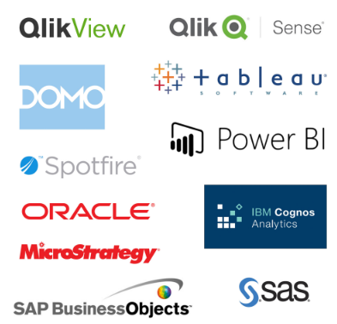
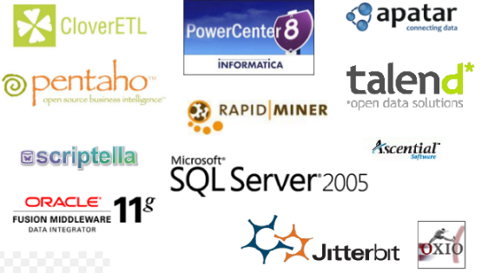
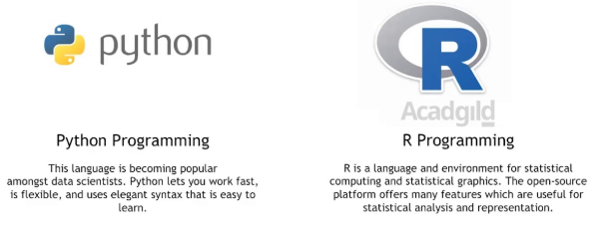
Industry Standard Tools & Technology

Slide 11
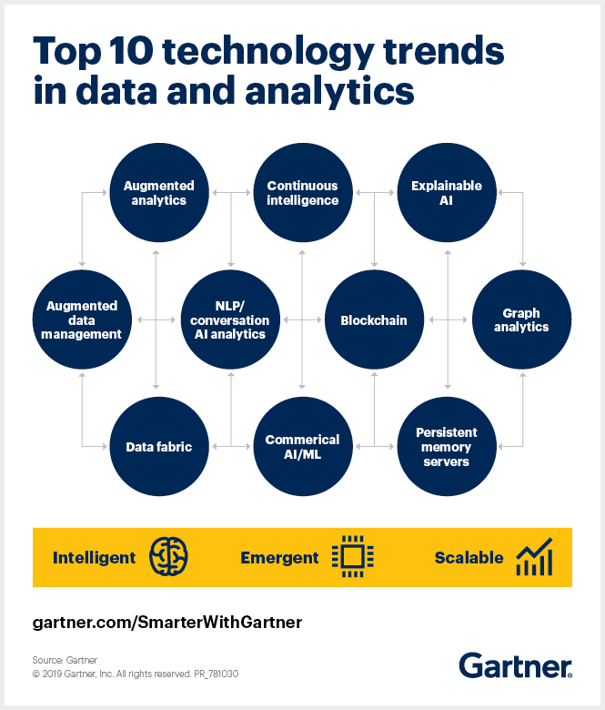
Notes:
Trend No. 1: Augmented analytics
Augmented analytics automates finding and surfacing the most important insights or changes in the business to optimize decision making. It does this in a fraction of the time compared to manual approaches.
Augmented analytics makes insights available to all business roles. While it reduces reliance on analytics, data science and machine learning experts, it will require increased data literacy across the organization.
By 2020, augmented analytics will be a dominant driver of new purchases of analytics and business intelligence as well as data science and machine learning platforms.
Trend No. 2: Augmented data management
With technical skills in short supply and data growing exponentially, organizations need to automate data management tasks. Vendors are adding machine learning and artificial intelligence (AI) capabilities to make data management processes self-configuring and self-tuning so that highly skilled technical staff can focus on higher-value tasks.
This trend is impacting all enterprise data management categories, including data quality, metadata management, master data management, data integration and databases.
Trend No. 3: Natural language processing (NLP) and conversational analytics
Just as search interfaces like Google made the internet accessible to everyday consumers, NLP gives business people an easier way to ask questions about data and to receive an explanation of the insights. Conversational analytics takes the concept of NLP a step further by enabling such questions to be posed and answered verbally rather than through text.
By 2021, NLP and conversational analytics will boost analytics and business intelligence adoption from 35% of employees to over 50%, including new classes of users, particularly front-office workers.
Watch webinar: Top 10 Data and Analytics Trends That Will Change Your Business
Trend No. 4: Graph analytics
Business users are asking increasingly complex questions across structured and unstructured data, often blending data from multiple applications, and increasingly, external data. Analyzing this level of data complexity at scale is not practical, or in some cases possible, using traditional query tools or query languages such as SQL.
The application of graph processing and graph databases will grow at 100% annually
Graph analytics is a set of analytic techniques that shows how entities such as people, places and things are related to each other. Applications of the technology range from fraud detection, traffic route optimization and social network analysis to genome research.
Gartner predicts that the application of graph processing and graph databases will grow at 100% annually over the next few years to accelerate data preparation and enable more complex and adaptive data science.
Trend No. 5: Commercial AI and machine learning
Open-source platforms currently dominate artificial intelligence (AI) and machine learning and have been the primary source of innovation in algorithms and development environments. Commercial vendors were slow to respond, but now provide connectors into the open-source ecosystem. They also offer enterprise features necessary to scale AI and ML, such as project and model management, reuse, transparency and integration — capabilities that open-source platforms currently lack.
Increased use of commercial AI and ML will help to accelerate the deployment of models in production, which will drive business value from these investments.
Trend No. 6: Data fabric
Deriving value from analytics investments depends on having an agile and trusted data fabric. A data fabric is generally a custom-made design that provides reusable data services, pipelines, semantic tiers or APIs via a combination of data integration approaches in an orchestrated fashion. It enables frictionless access and sharing of data in a distributed data environment.
Trend No. 7: Explainable AI
Explainable AI increases the transparency and trustworthiness of AI solutions and outcomes, reducing regulatory and reputational risk. Explainable AI is the set of capabilities that describes a model, highlights its strengths and weaknesses, predicts its likely behavior and identifies any potential biases.
Without acceptable explanation, autogenerated insights or “black-box” approaches to AI can cause concerns about regulation, reputation, accountability and model bias.
Trend No. 8: Blockchain in data and analytics
Blockchain technologies address two challenges in data and analytics. First, blockchain provides the lineage of assets and transactions. Second, it provides transparency for complex networks of participants.
However, blockchain is not a stand-alone data store and it has limited data management capabilities. A blockchain-based system can’t serve as a system of record, meaning a huge integration effort involving data, applications and business processes. Realistically, the technology hasn’t yet matured to real-world, production-level scalability for use cases beyond cryptocurrency.
Trend No. 9: Continuous intelligence
Organizations have long sought real-time intelligence, and systems are available to do this for a limited set of tasks. Now it is finally practical to implement these systems — what Gartner calls continuous intelligence — on a much broader scale because of the cloud, advances in streaming software and growth data from sensors in the Internet of Things (IoT).
By 2022, more than half of major new business systems will incorporate continuous intelligence that uses real-time context data to improve decisions.
Trend No. 10: Persistent memory servers
Most database management systems (DBMS) make use of in-memory database structures, but with data volumes growing rapidly, memory size can be restrictive. New server workloads are demanding not just faster processor performance, but also massive memory and faster storage.
Persistent memory technology will help businesses extract more actionable insights from data. Many DBMS vendors are experimenting with persistent memory, although it may take several years to modify their software to take advantage of it.

Slide 12
Q&A

